Slide 1

Graph Attention Networks

Slide 2
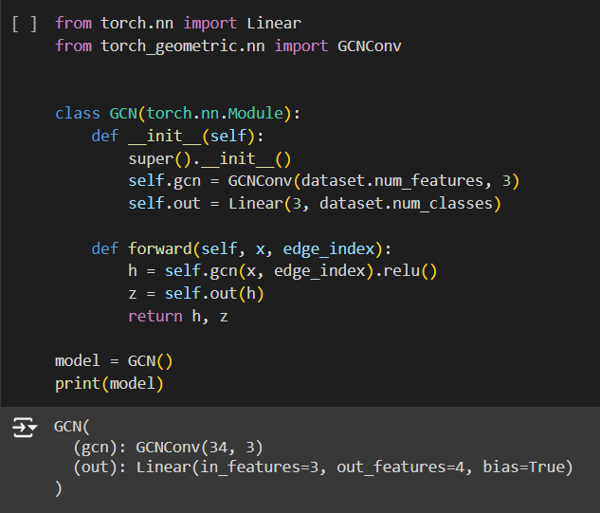
Implementation of GCN

Slide 3
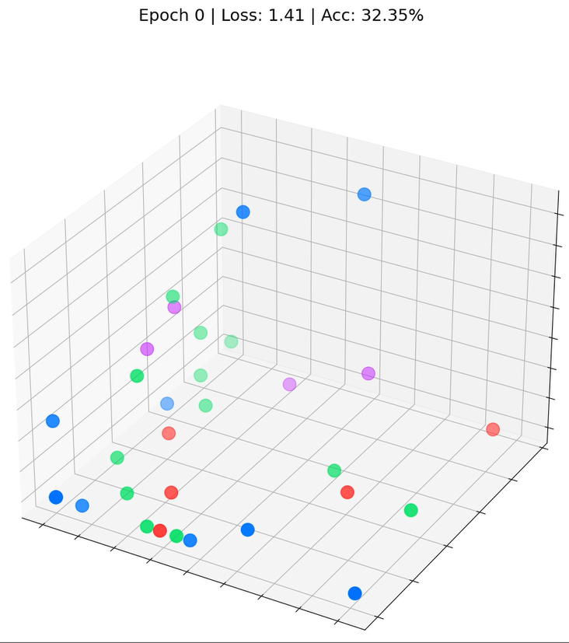
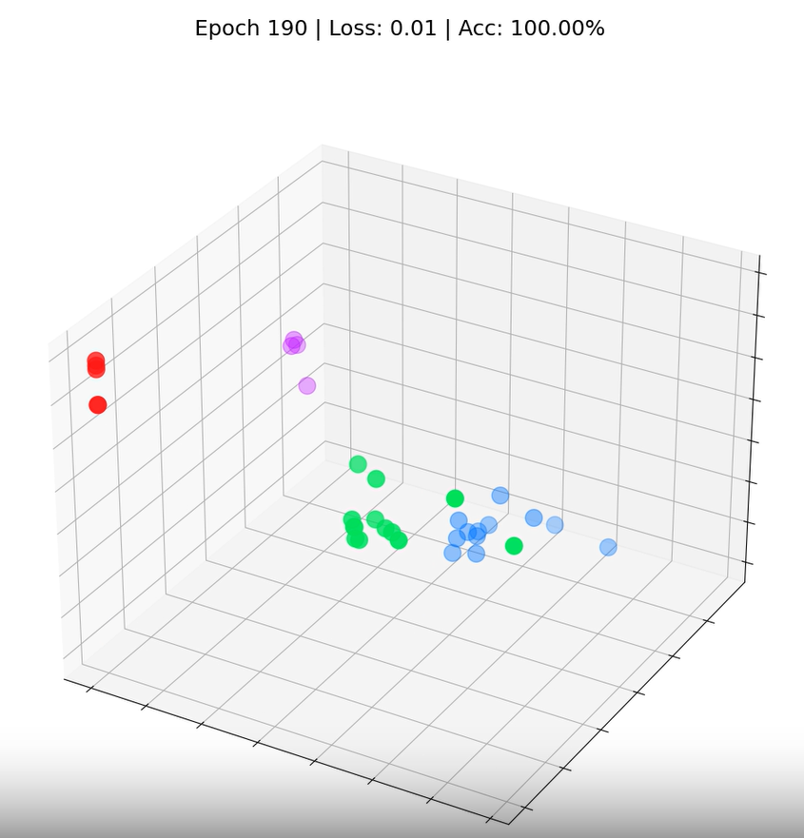
Our Graph Convolutional Network (GCN) has effectively learned embeddings that group similar nodes into distinct clusters. This enables the final linear layer to distinguish them into separate classes with ease.

Slide 4
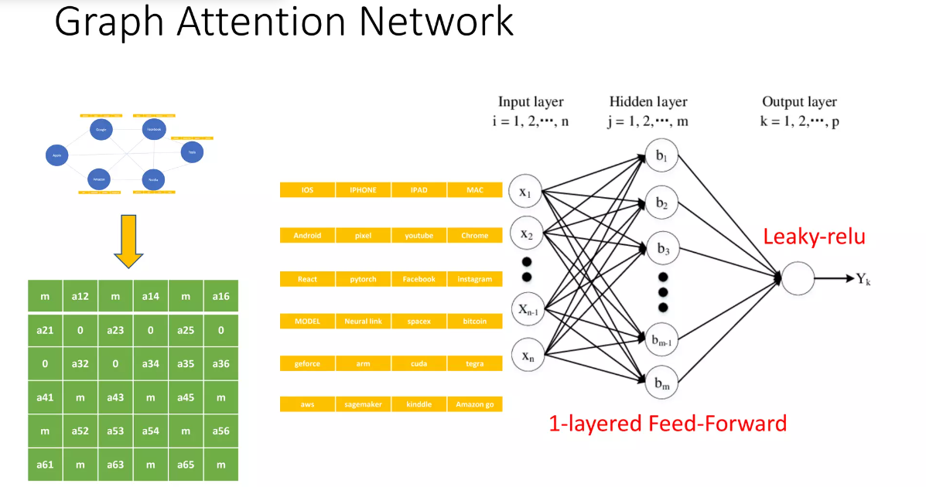

Slide 5
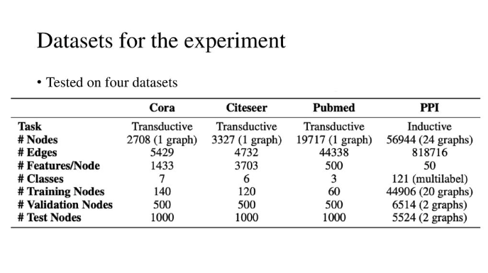

Slide 6
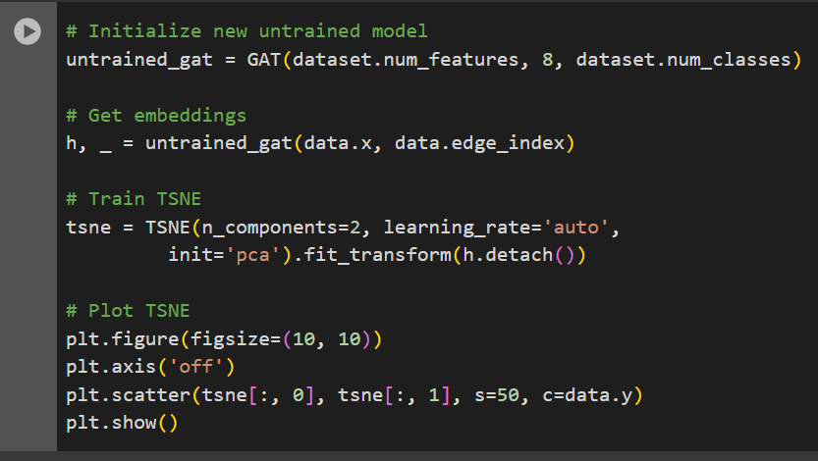
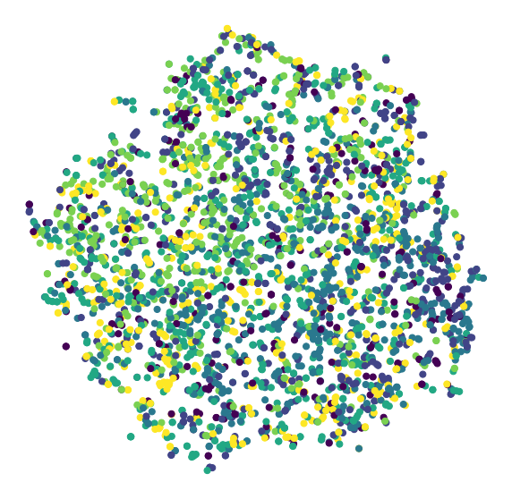
Implementation of Graph Attention Network
We can visualize it with t-SNE plot, a powerful method to plot high-dimensional data in 2D or 3D. First, let’s see what the embeddings looked like before any training: it should be random since they’re produced by randomly initialized weight matrices.

Slide 7
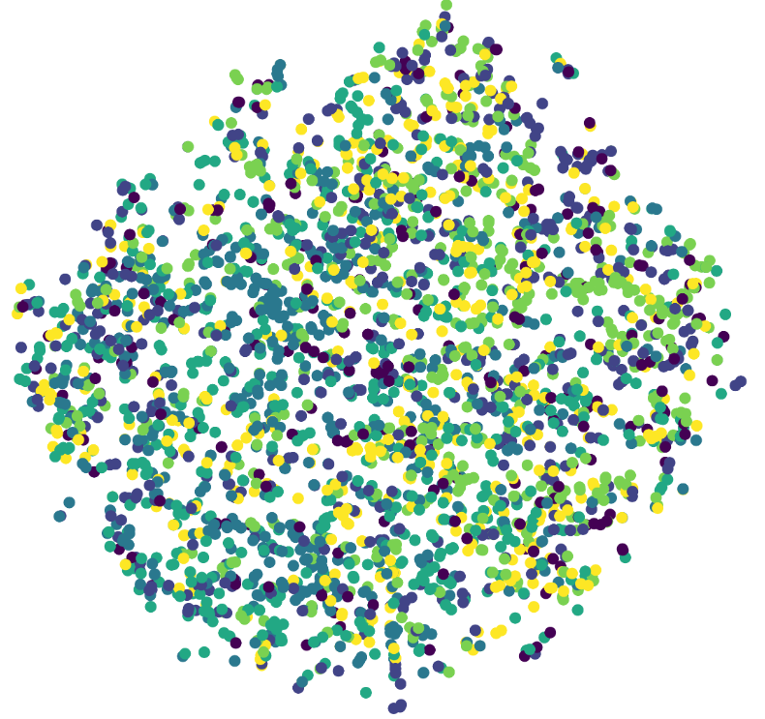
Indeed, there’s no apparent structure. But do the embeddings produced by our trained model look better?

Slide 8
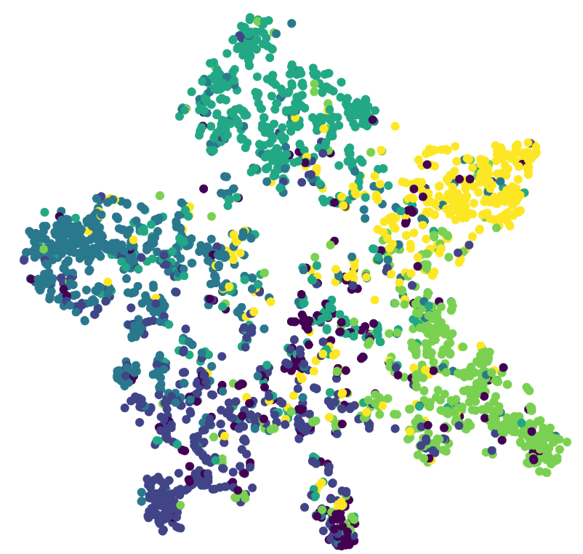
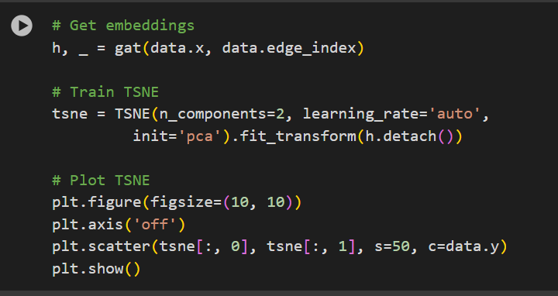
The difference is noticeable: nodes belonging to the same classes cluster together. We can see six clusters, corresponding to the six classes of papers. There are outliers, but this was to be expected: our accuracy score is far from perfect.

Slide 9
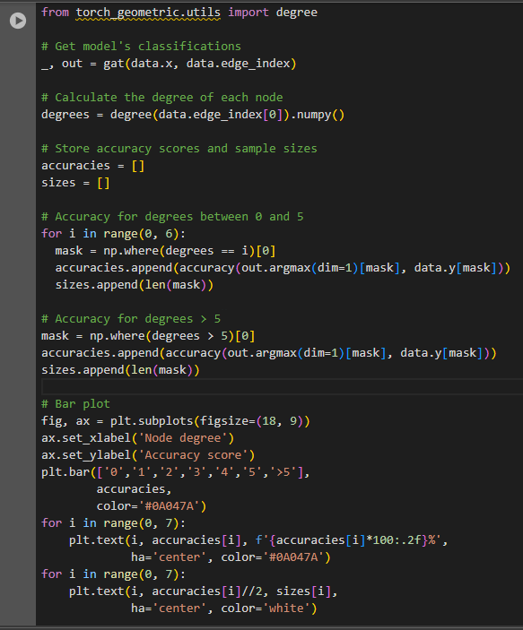
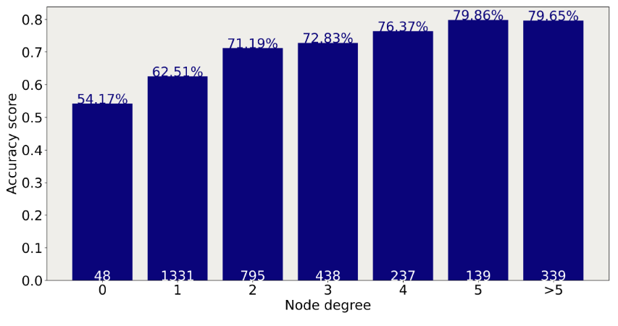
we speculated that poorly connected nodes might negatively impact performance on CiteSeer. So let’s verify that by calculating the model’s accuracy for each degree.
These results confirm our intuition: nodes with few neighbors are indeed harder to classify. This is due to the nature of GNNs: the more relevant connections you have, the more information you can aggregate.

Slide 10
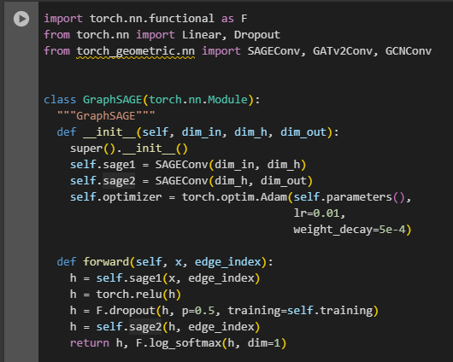
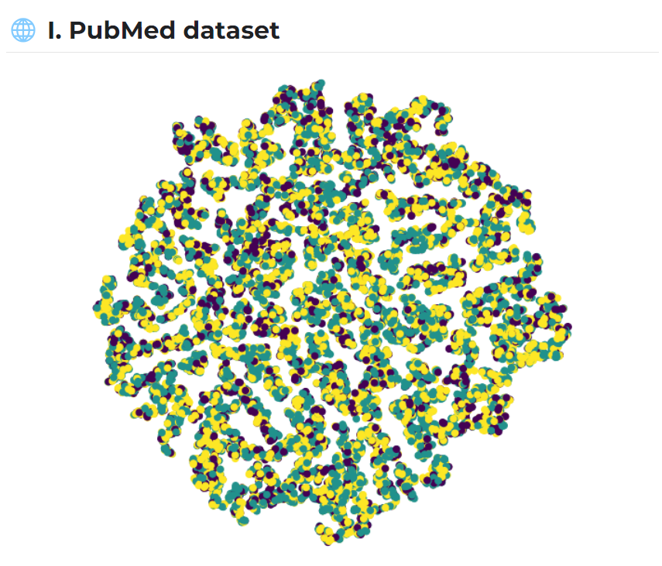
Implementation of GraphSage

Slide 11
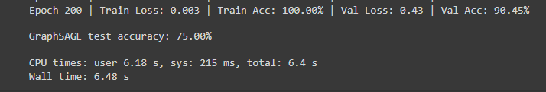
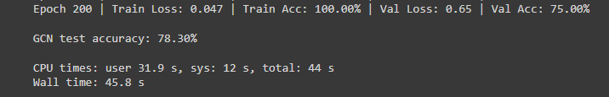
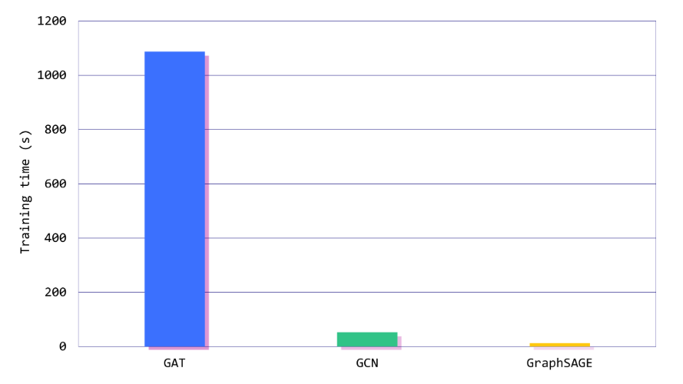
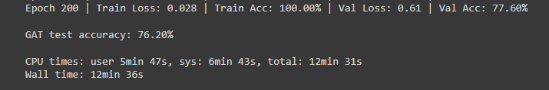
GraphSage vs GCN vs GAT
The three models obtain similar results in terms of accuracy.
The real difference is the training time: GraphSAGE is 88 times faster than the GAT and four times faster than the GCN in this dataset!

Slide 12
Summary
We explored a new dataset with PubMed, which has almost ten times more connections than the previous one (CiteSeer).
We benchmarked three models (GraphSAGE, GAT, and GCN) in terms of accuracy and training time.

Slide 13
THANK YOU

